Slide 1
SCMHRD · MBA FINANCE · SEMESTER 3 · ONE-DAY INTENSIVE
TODAY
AI in Finance
From LLMs to Agentic AI — concepts, systems and four live builds
10 AM – 1 PM
Foundations: AI, GenAI,
Agents & Enterprise AI
2 PM – 5 PM
Finance applications,
four live builds + project
Tejas Jadhav, CFA, FRM
Guest Faculty · Curated with Dr. Dipasha Sharma, SCMHRD
github.com/tejasgjadhav/SCMHRD
4
LIVE BUILDS SHIPPED
BEFORE 5 PM
AI IN FINANCE · SCMHRD ONE-DAY INTENSIVE
WELCOME · 01

Slide 2
THE PLAN
One day. Two slots. Zero coding background assumed.
SLOT 1 · FOUNDATIONS 10 AM – 1 PM
SLOT 2 · BUILD & APPLY 2 PM – 5 PM
▪ AI, Machine Learning and Generative AI — from zero
▪ Build 1 — Trading algo system (momentum, mean reversion)
▪ LLMs: how they actually work (no maths needed)
▪ Build 2 — VaR Backtesting engine (Sharpe, drawdown)
▪ Prompting, context windows and memory
▪ Build 3 — Earnings-call dashboard with sentiment
▪ Hallucinations — the types that hurt in finance
▪ Build 4 — Portfolio review + Basel report
▪ RAG: making AI answer from your documents
▪ Live project — graded group assignment briefing
▪ Agents, loops & skills · LangChain · LangGraph · MCP
▪ AI-finance careers, skill stack & placement map
▪ Enterprise AI: data protection, token costs, governance
▪ Recap, resources + Q&A
Morning = concepts with finance use cases. Afternoon = you build, in groups, with AI doing the coding for you.
AI IN FINANCE · SCMHRD ONE-DAY INTENSIVE
DAY MAP · 02

Slide 3
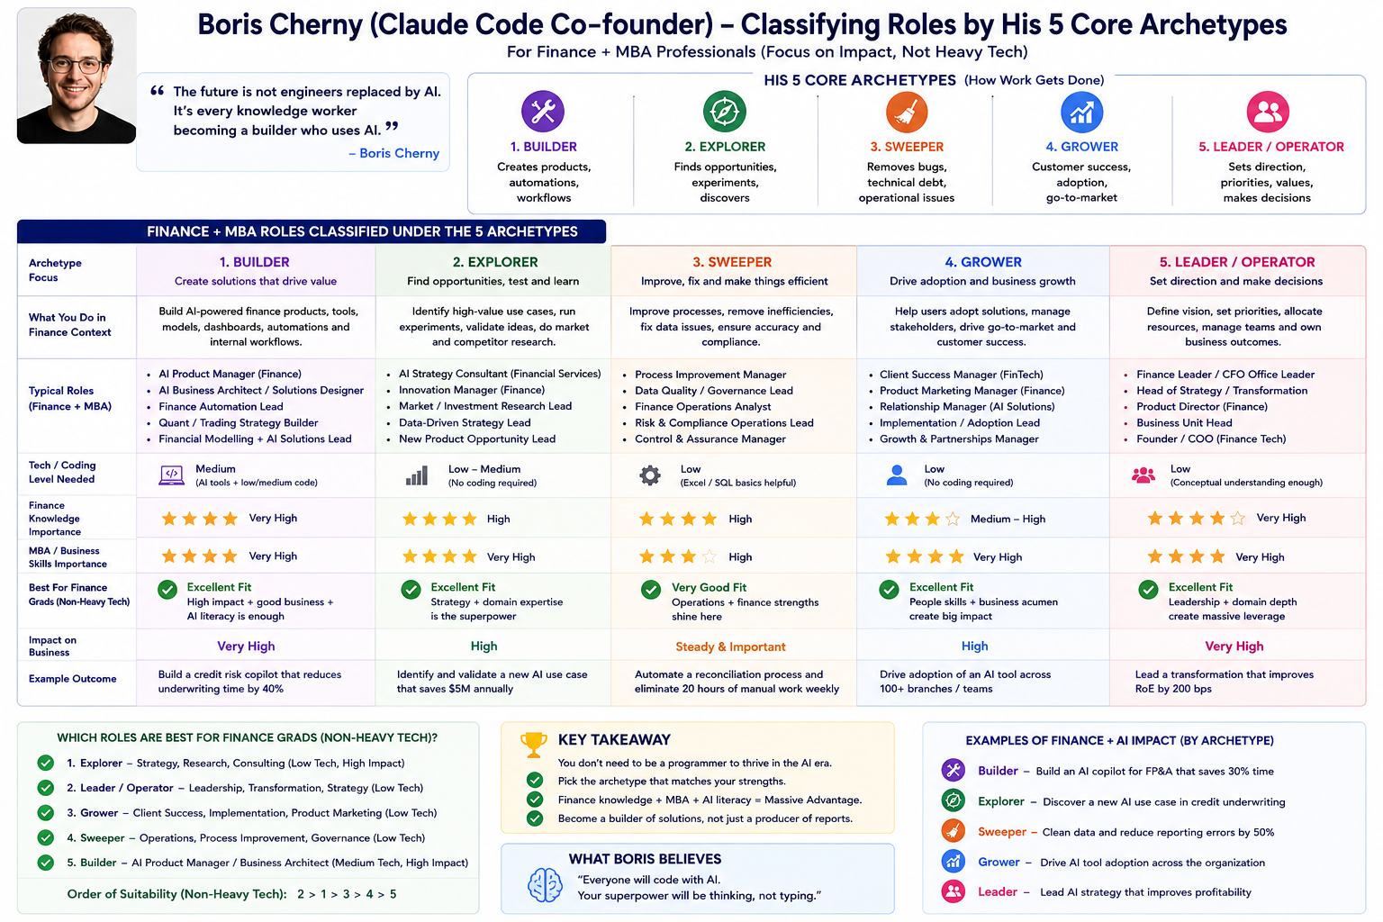

Slide 4
01
Session 1 · Foundations
AI → Generative AI → LLMs → Agents → Agentic AI → Enterprise AI
10:00
AI & GenAI basics
10:45
Prompts · context · memory
11:15
Hallucinations & RAG
11:55
Agents & Agentic AI
12:30
LangChain · LangGraph · MCP
12:50
Recap & live demo
AI IN FINANCE · SCMHRD ONE-DAY INTENSIVE
SESSION 1 · 03

Slide 5
BLOCK A · BASICS
What is AI? Four nested ideas
ARTIFICIAL INTELLIGENCE
Any software that mimics human judgement
AI
The umbrella. Rules, logic, prediction — e.g. a loan-eligibility rule engine.
MACHINE LEARNING
Learns rules from data instead of being programmed
Machine Learning
DEEP LEARNING
Neural networks — learns from raw text, images, sound
Show it 1 lakh past loans; it learns which borrowers default. No rules hand-written.
GENERATIVE AI · LLMs
Creates new text, code and analysis — ChatGPT, Claude
Deep Learning
ML with many-layered neural networks. Powers fraud detection, face-KYC, speech.
Generative AI
Doesn't just score or classify — it writes. Research notes, memos, code, emails.
AI IN FINANCE · SCMHRD ONE-DAY INTENSIVE
SESSION 1 · 04

Slide 6
BLOCK A · BASICS
How machines learn — three flavours
LEARN FROM LABELLED HISTORY
Supervised learning
Feed it past data with answers attached: loans → defaulted / repaid.
Segmentation or Regression y=f(X)
Finance: credit scoring, fraud flags, house-price models
FIND HIDDEN STRUCTURE
Unsupervised learning
No answers given. The model groups similar things on its own.
Finance: Banks group clients by financial behavior (e.g., spending, investments, credit history) without predefined labels to tailor targeted marketing campaigns and product offerings
Association – Swiggy bundling
LEARN BY TRIAL & REWARD
Reinforcement learning
An agent tries actions, gets rewards or penalties, improves over time.
Finance: order execution Algotrading (Train your dog) Chess Sacrifice maximize the Return
Key intuition: classical ML predicts a number or a label. Generative AI produces language. LLMs are deep learning applied to one task — predicting the next word — at colossal scale.
AI IN FINANCE · SCMHRD ONE-DAY INTENSIVE
SESSION 1 · 05

Slide 7
BLOCK A · BASICS
Predictive AI vs Generative AI
 | Predictive (classical) AI | Generative AI
Output | A number, score or label | New content — text, tables, code, memos
Question it answers | “Will this borrower default?” | “Draft the credit appraisal note.”
Data needed | Structured (spreadsheets, ledgers) | Unstructured too (filings, calls, news)
Typical desk use | Fraud scores, ratings, forecasts | Research summaries, IC memos, emails
Failure mode | Wrong number | Confident, fluent nonsense (hallucination)
Why an MBA should care
Predictive AI automated the calculation layer of finance. Generative AI is now automating the language layer — memos, research, client letters, compliance drafts — which is most of what analysts produce in their first three years.
AI IN FINANCE · SCMHRD ONE-DAY INTENSIVE
SESSION 1 · 06

Slide 8
BLOCK A · BASICS
The LLM — autocomplete trained on the internet
HOW IT'S BUILT
ONE JOB: PREDICT THE NEXT WORD
“The RBI raised the repo ____”
1 · Pre-training
Read trillions of words — books, filings, the web. Learn language, facts, reasoning patterns. NLP- Natural language processing- LLM uses
rate
92%
rating
4%
report
2%
2 · Fine-tuning
Teach it to follow instructions: “summarise”, “compare”, “draft”.
Tokens — the model's unit of text
Words are split into chunks (≈ ¾ of a word each). “Derivatives” → deriv + atives. Models read, think and charge per token.
Context windows, API pricing and speed are all quoted in tokens — it's the metre of this world.
A 200-page annual report ≈ 100,000 tokens.
3 · Human feedback (RLHF)
Humans rank answers; the model learns to be helpful, honest, harmless. Reinforcued learning from Human feedback
It has no database of truth — it generates the most plausible next words.
AI IN FINANCE · SCMHRD ONE-DAY INTENSIVE
SESSION 1 · 07

Slide 9
BLOCK A · BASICS
The model landscape in 2026
KNOWN FOR
PICK IT WHEN
OpenAI — GPT family
ChatGPT; strongest brand, broad ecosystem
Everyday analysis, drafting, coding
Anthropic — Claude
Long documents, careful reasoning, agents & coding
Research over filings, agentic workflows
Google — Gemini
Native to Workspace; huge context windows
Teams already on Google stack
Meta — Llama (open)
Open-weights: run it on your own servers
Banks needing data to stay in-house
BloombergGPT / FinBERT
Domain models trained on finance text
Terminal workflows, sentiment scoring
Closed models = rented via API, best quality. Open models = downloaded and self-hosted — banks often choose these for confidential data.
AI IN FINANCE · SCMHRD ONE-DAY INTENSIVE
SESSION 1 · 08

Slide 10
BLOCK A · BASICS
The big four, compared — why we run on Claude
 | GPT (OpenAI) | Claude (Anthropic) | Gemini (Google) | Llama (Meta)
Reasoning depth | Strong across tasks | Strongest on long, multi-step analysis — holds an argument across a 300-page document | Strong, fast improving | Good; varies by size
Long documents | ~128K tokens | 200K tokens — a full annual report in one pass | Up to 1M tokens | Depends on host
Honesty under uncertainty | Good | Tuned to say “I don't know” rather than invent — lowest fabrication tendency | Good | Depends on tuning
Agents & tool use | Strong ecosystem | Agent-native — created MCP; leads on tool use & coding agents | Strong in Google stack | DIY — you wire it
Access | API · ChatGPT | API · claude.ai · Claude Code | API · Workspace | Open weights, self-host
WHY CLAUDE FOR THIS COURSE
(1) Reasoning: deepest sustained analysis on long, messy finance documents — 10-Ks, reg text, transcripts. (2) Honesty: trained to admit uncertainty instead of inventing — exactly the guardrail we teach. (3) Agent-native: Anthropic created MCP; Claude leads on tool use and coding agents — today's builds run on it.
To be fair: all four are world-class, and every skill you learn today transfers across them. Model choice is a decision, not a religion.
AI IN FINANCE · SCMHRD ONE-DAY INTENSIVE
SESSION 1 · 09

Slide 11
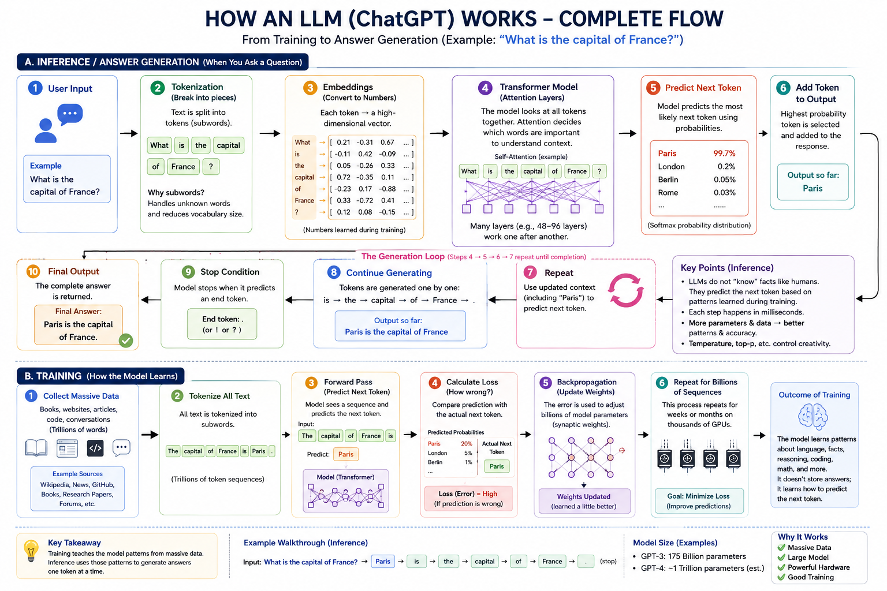

Slide 12
BLOCK A · BASICS
Glossary I — words you'll hear all day
Term | Plain-English meaning | Finance example
Model | The trained “brain” — a giant pattern-matcher built from data | GPT, Claude and Gemini are all models
Training vs inference | Training = building the brain (once, costly). Inference = using it (every chat) | Your ChatGPT question = one inference call
Parameters | The dials inside the brain — more dials, more capability | “175B parameters” ≈ brain size, not IQ
Token | The unit of text models read and bill by (≈ ¾ of a word) | A 200-page annual report ≈ 100,000 tokens
Embedding | Text converted into numbers that capture its meaning | “profit fell” and “earnings declined” land side by side
Vector database | A library indexed by meaning, not keywords | Search “margin pressure”, find “pricing headwinds”
Temperature | The creativity dial — low = consistent, high = varied | Compliance drafts at 0.2, brainstorms at 0.9
API | The plug that lets software call a model programmatically | An Excel add-in querying Claude = an API call
AI IN FINANCE · SCMHRD ONE-DAY INTENSIVE
SESSION 1 · 10

Slide 13
BLOCK B · WORKING WITH MODELS
Prompt engineering — the anatomy of a good ask
ROLE
Who the AI should be
“You are a sell-side equity analyst…”
A DESK-READY PROMPT
You are a credit analyst at a large Indian bank.
Using only the attached FY25 annual report of Tata Motors,
assess debt-servicing capacity: leverage, coverage, maturity wall.
Output a one-page credit note: 5 bullets, one ratio table, a stated recommendation.
If a number is not in the report, say “not disclosed” — do not estimate.
That last line is a hallucination guardrail — you'll see why in 20 minutes.
CONTEXT
Facts it must use
“Here is HDFC Bank's Q3 press release…”
TASK
One clear instruction
“Summarise NIM drivers in 5 bullets…”
FORMAT
Shape of the output
“…as a table: metric, QoQ change, driver.”
EXAMPLE
Show one done right
“Follow the style of this sample memo…”
AI IN FINANCE · SCMHRD ONE-DAY INTENSIVE
SESSION 1 · 11

Slide 14
BLOCK B · WORKING WITH MODELS
Prompt patterns and anti-patterns
DO
DON'T
▪ Give the source document, then ask the question
▪ “Tell me about HDFC Bank” — vague, no source, no task
▪ Ask for the format: table, memo, 5 bullets, JSON
▪ Trusting numbers it produces from memory
▪ “Think step by step” for calculations & logic
▪ One giant prompt asking 6 things at once
▪ Ask it to cite the page/section for every claim
▪ Sharing client PII / MNPI with public chatbots
▪ Iterate — treat the first answer as a draft
▪ Assuming it knows events after its training cut-off
▪ “If unsure or missing data, say so”
▪ Copy-pasting output into an IC deck unreviewed
AI IN FINANCE · SCMHRD ONE-DAY INTENSIVE
SESSION 1 · 12

Slide 15
BLOCK B · WORKING WITH MODELS
Context window — the model's working desk
The analogy
An analyst can only work with the papers currently on her desk. The context window is that desk: everything the model can “see” right now — your prompt, the documents you pasted, the conversation so far.
Off the desk = invisible. The model does not remember yesterday's chat by itself.
Why you care 1 — cost & speed
Bigger context = more tokens = slower and costlier. Send what matters, not everything.
Why you care 2 — lost in the middle
Models attend best to the start and end of long context. Put key facts up front.
DESK SIZES (TOKENS → ROUGHLY)
8K — early GPT-4 ≈ one earnings press release
128K — GPT-4 class ≈ one full annual report
Why you care 3 — it fills up
A quarter's worth of policy documents won't fit. That problem is exactly what RAG solves (2 slides away).
200K–1M — Claude / Gemini ≈ several annual reports + models
AI IN FINANCE · SCMHRD ONE-DAY INTENSIVE
SESSION 1 · 13

Slide 16
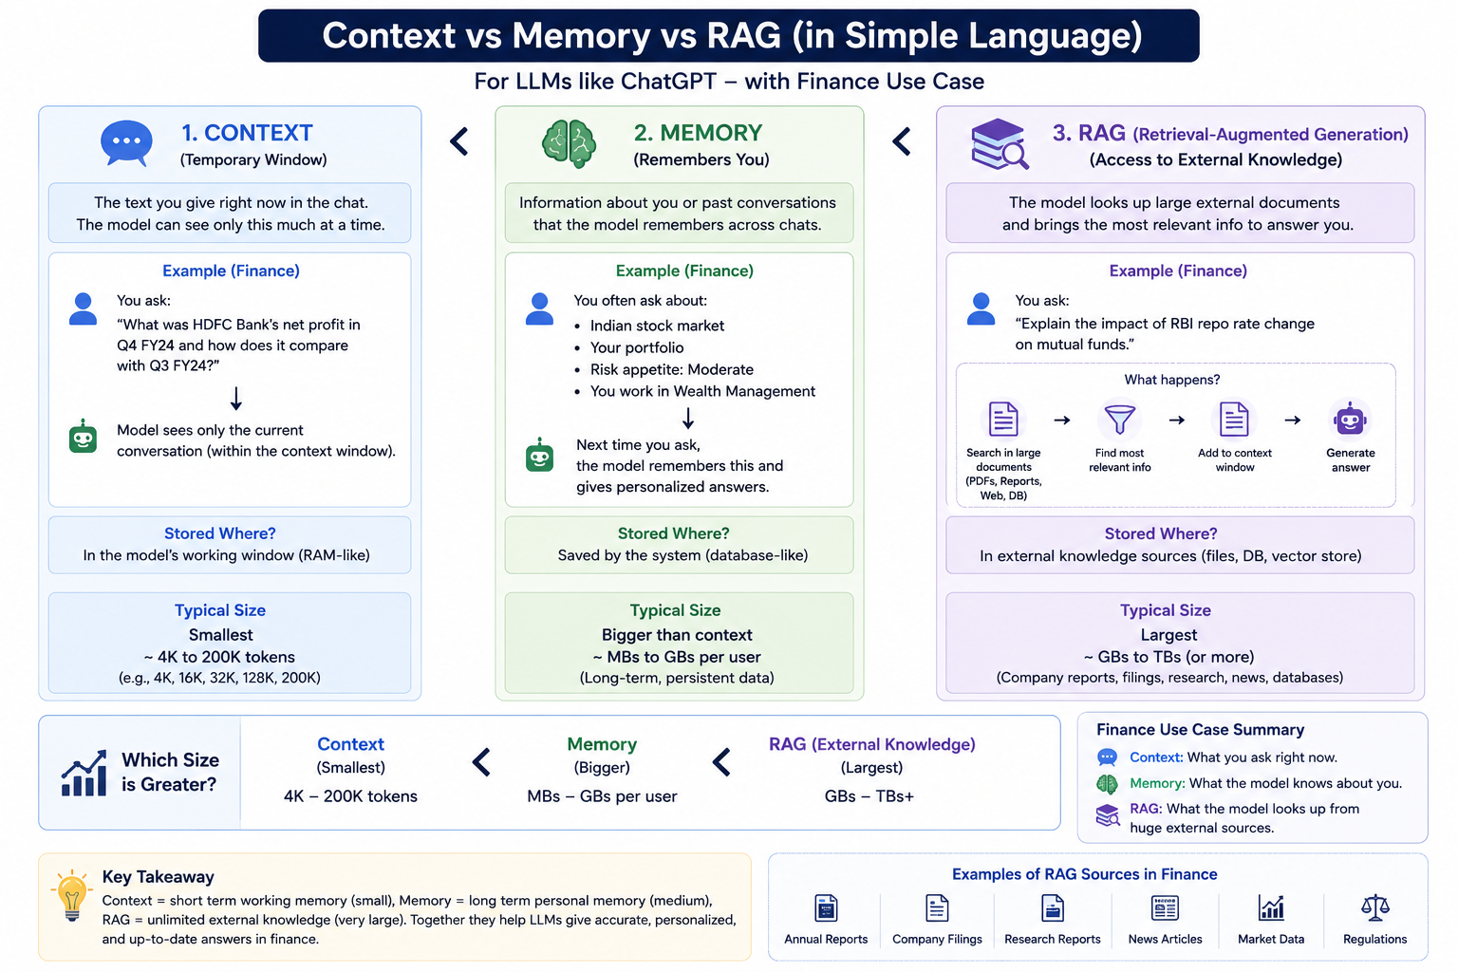

Slide 17
BLOCK B · WORKING WITH MODELS
Memory — how AI systems remember
Short-term memory
= the context window itself. Lives only inside this conversation. Close the chat, it's gone.
Long-term memory
= facts written to an external store (database / notes) and re-inserted into context when relevant. This is engineered, not innate.
WHAT GETS STORED — THREE TYPES
Episodic · What happened
“On 12 Mar the client rejected the small-cap tilt.”
Semantic · Facts & preferences
“Client is NRI; conservative; no tobacco stocks.”
Procedural · How to do things
“Always produce reviews in the firm's IPS format.”
Wealth-management use case: an advisory copilot that remembers every client's risk profile, past objections and tax situation across months of conversations — and drafts the next review accordingly.
AI IN FINANCE · SCMHRD ONE-DAY INTENSIVE
SESSION 1 · 14

Slide 18
BLOCK C · TRUST
Hallucination — fluent, confident, wrong
Definition
The model produces content that is plausible-sounding but false or unsupported — invented numbers, fake citations, misread facts.
It is not lying. It is doing its job — predicting likely words — when the truth isn't in its context.
Trained to continue, not verify
Its objective is plausibility. There is no built-in fact-checker.
Gaps get papered over
If data is missing or after its knowledge cut-off, it fills the gap smoothly.
A real desk example
“What was Infosys' FY24 attrition rate?”
Without the report in context, a model may answer “14.6% (Annual Report, p. 83)” — number and page both invented, formatted perfectly.
Your prompt can push it
Leading questions (“confirm that…”) invite agreeable fiction.
Confidence ≠ accuracy
Tone stays equally assured whether it's right or wrong — that's the danger.
AI IN FINANCE · SCMHRD ONE-DAY INTENSIVE
SESSION 1 · 15

Slide 19
BLOCK C · TRUST
Know your hallucinations — five types
1 · Factual
States wrong real-world facts
“SEBI caps mutual-fund expense ratios at 3.5%” — outdated / wrong.
2 · Faithfulness
Contradicts the document you gave it
Summary says margin “expanded”; the 10-K says it contracted.
3 · Fabricated sources
Invents citations, cases, papers
Cites “RBI Circular 2023/114” — no such circular exists.
4 · Numeric / reasoning
Right facts, wrong arithmetic or logic
Adds segment revenues incorrectly; flips a sign in a DCF.
5 · Context confusion
Mixes entities, periods or currencies
Blends FY23 and FY24 figures; confuses Tata Motors with Tata Steel.
In finance the stakes compound: a hallucinated covenant, NAV or reg citation can move money and trigger liability. Treat every unsourced number as unverified.
AI IN FINANCE · SCMHRD ONE-DAY INTENSIVE
SESSION 1 · 16

Slide 20
BLOCK C · TRUST
Taming hallucinations — the practical toolkit
Ground it (RAG)
Demand citations
Give the model the actual documents and instruct: answer only from these. The single biggest fix — next slide.
“Cite page and section for every figure.” Fabricated cites become easy to catch.
Allow “I don't know”
Lower the temperature
Explicitly permit it to say data is missing. Removes the pressure to invent.
A sampling dial: lower = more conservative, repeatable answers for factual work.
Verify high-stakes output
Evaluate continuously
Human-in-the-loop for anything that faces a client, regulator or trade.
Banks run automated “exam papers” (evals) against known answers before deployment.
Desk rule: AI drafts, humans sign. The accountability never transfers to the model.
AI IN FINANCE · SCMHRD ONE-DAY INTENSIVE
SESSION 1 · 17

Slide 21
BLOCK C · TRUST
RAG — Retrieval-Augmented Generation
Open-book exam instead of memory test: fetch the right pages from your library, hand them to the model, and let it answer from them.
STEP 1 · INDEX YOUR LIBRARY (DONE ONCE)
Your documents
10-Ks · policies · research · contracts
Chunk & embed
split into passages → convert to number-vectors that capture meaning
Vector database
a searchable index of meaning, not keywords
STEP 2 · ANSWER A QUESTION (EVERY QUERY)
Question
“What are our Basel III disclosure gaps?”
Retrieve top passages
the 5–10 most relevant chunks
LLM + passages
question and evidence go in together
Cited answer
with page refs
Why banks love it: answers come from approved internal documents (auditable), stay current without retraining the model, and hallucination drops sharply because the evidence is in the prompt.
AI IN FINANCE · SCMHRD ONE-DAY INTENSIVE
SESSION 1 · 18

Slide 22
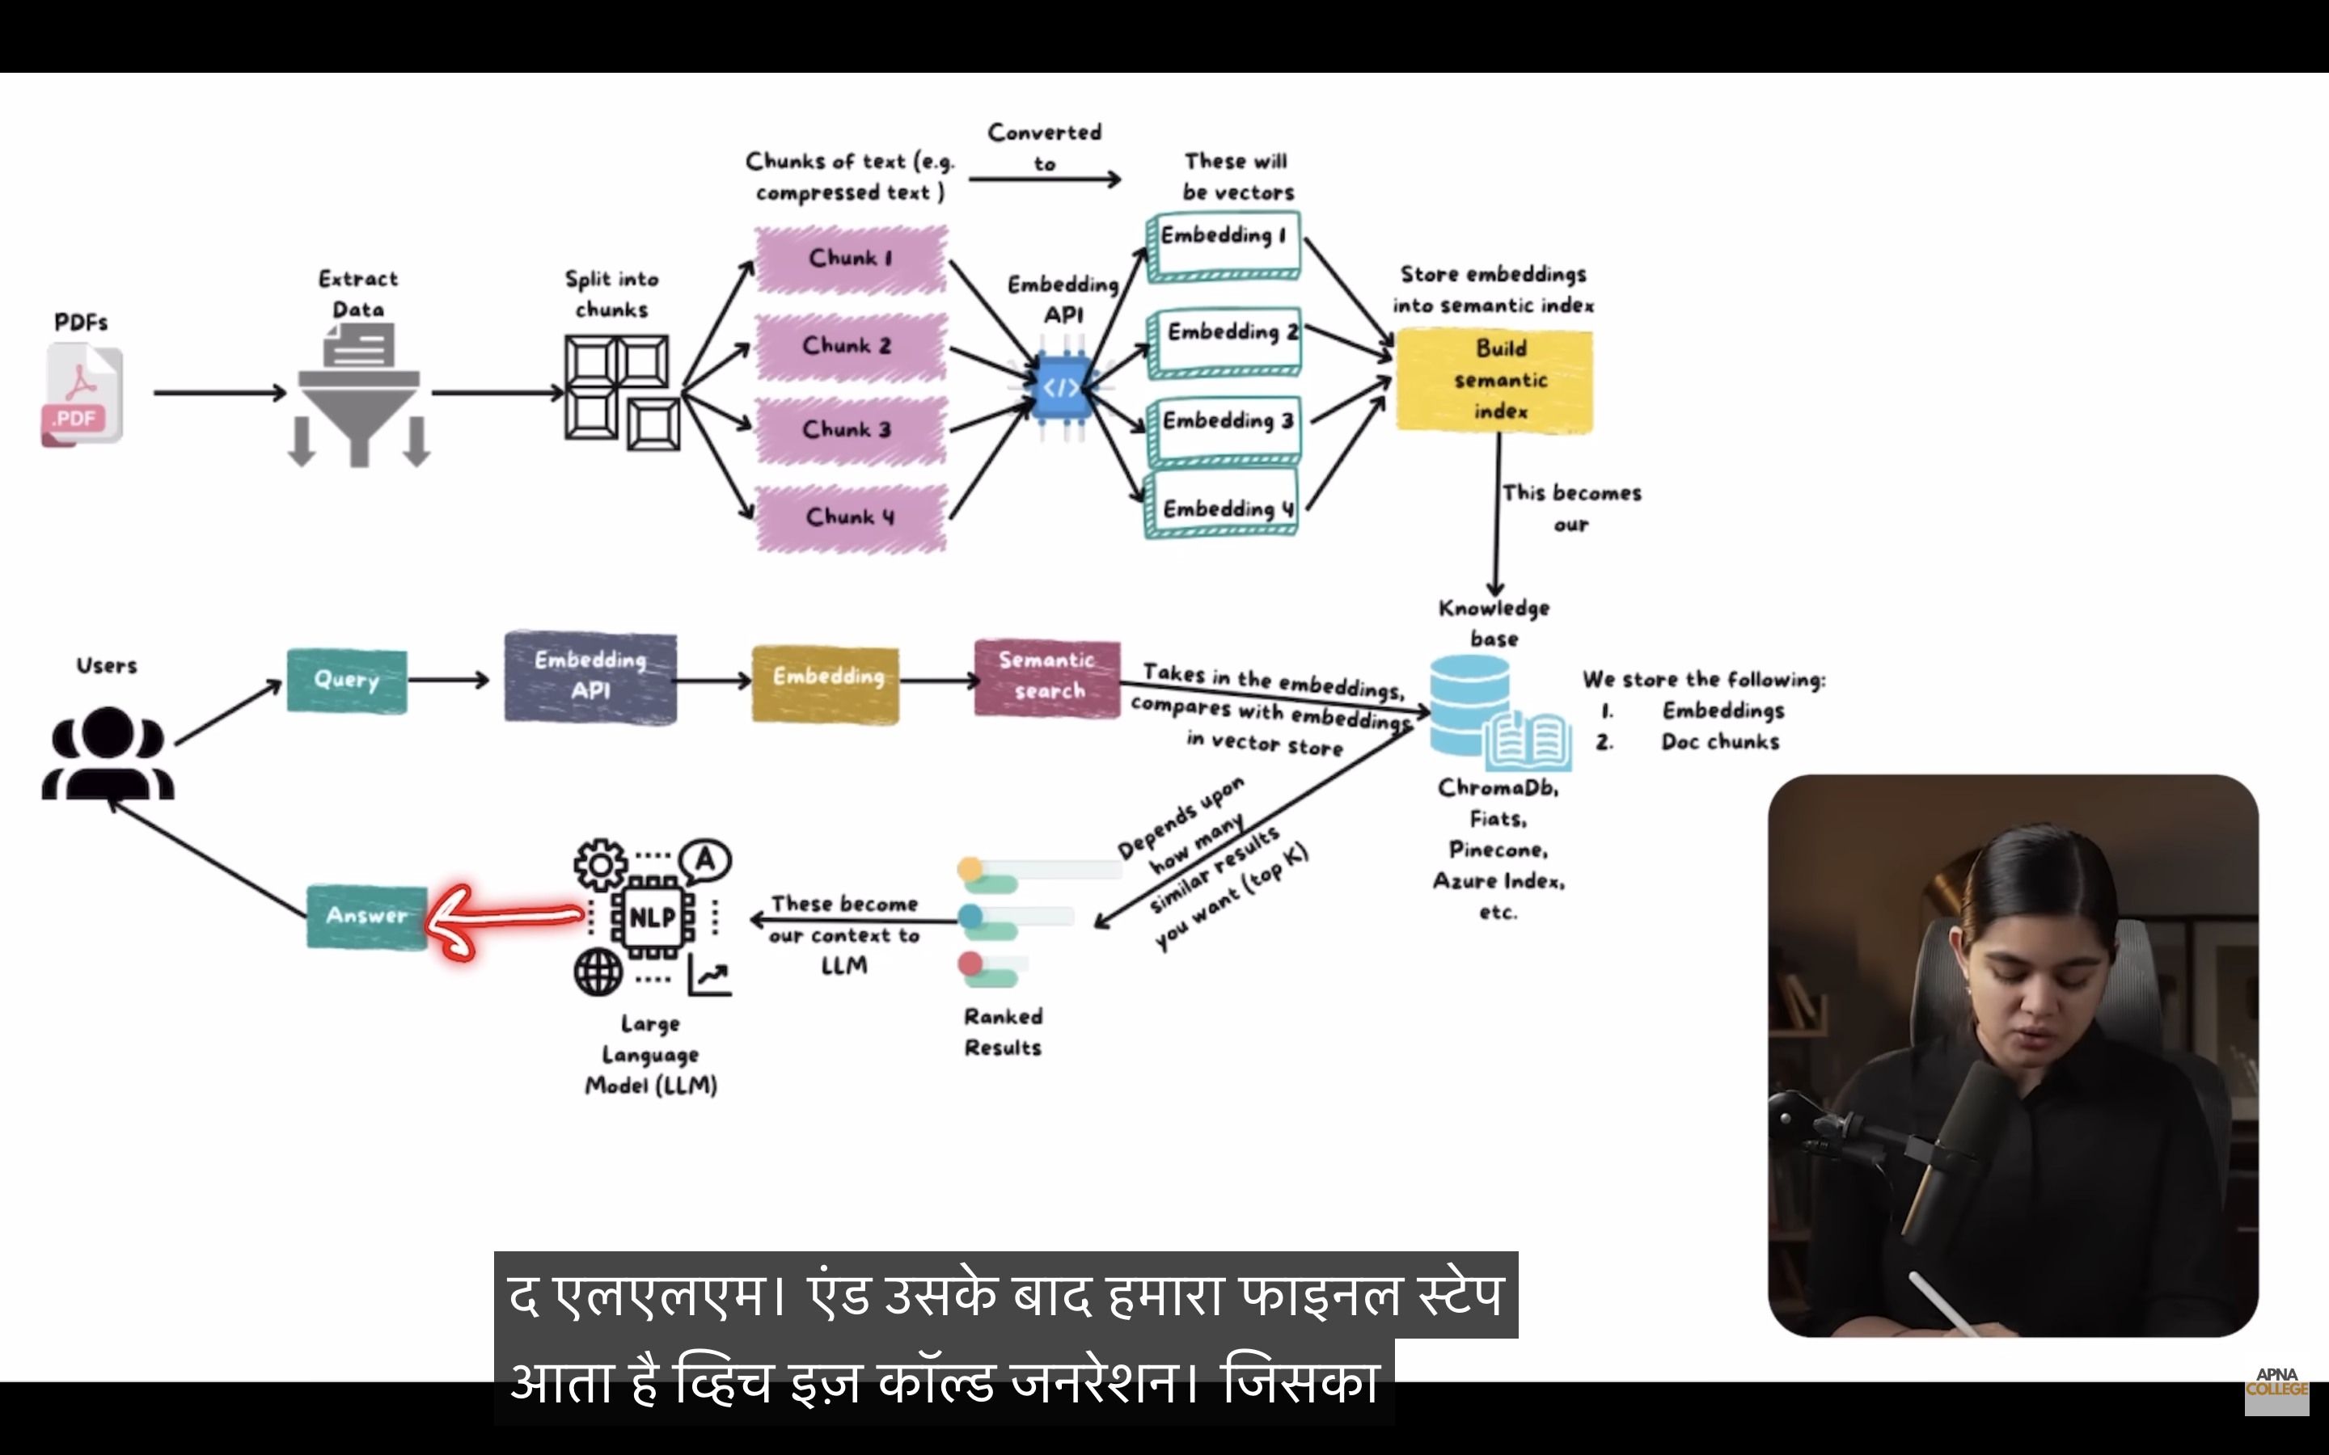

Slide 23
BLOCK C · TRUST
RAG on the desks — where it's already deployed
Wealth advisory · Morgan Stanley
GPT-4 over 100,000+ internal research and compliance documents. Advisors get vetted answers in seconds instead of searching portals.
Policy & KYC ops · Universal banks
“Can an NRI open this account with these documents?” — answered from the bank's own policy manual, with clause citations.
Equity research · Buy & sell side
Ask questions across 10 years of annual reports and call transcripts: “Every mention of pricing pressure since FY19, with sources.”
Regulatory & risk · Basel / RBI compliance
RAG over Basel IV texts, RBI master directions and internal capital policy — drafts gap analyses your Build 4 will replicate today.
AI IN FINANCE · SCMHRD ONE-DAY INTENSIVE
SESSION 1 · 19

Slide 24
BLOCK D · AGENTS
From chatbot to agent — answering vs doing
LLM
the brain
Tools
hands — APIs, code,
search, spreadsheets
Memory
notebook — state
across steps
Planning
the to-do list —
decide, act, check
AGENT
works toward a goal
+
+
+
=
 | Chatbot | Agent
You ask | “What is Infosys' P/E?” | “Review my portfolio and flag concentration risks.”
It does | Answers from context in one shot | Fetches prices → computes weights → checks limits → drafts memo
Steps | One | Many — it decides the sequence itself
Trust needed | Verify the answer | Verify the actions — permissions matter
AI IN FINANCE · SCMHRD ONE-DAY INTENSIVE
SESSION 1 · 21

Slide 25
BLOCK D · AGENTS
Anatomy of an agent
Goal from user
“Prepare the monthly portfolio review”
Memory
conversation state · client facts · past runs
LLM CORE
reasons, plans, decides the next step
Tools
market-data API · Python · database · email
Without memory it repeats questions and forgets constraints.
Without tools it can only talk. Tools are where work happens — and where permissions live.
Act → observe → repeat
loops until the goal is met, then reports
One sentence: an agent is an LLM in a loop, with tools, memory and a goal.
AI IN FINANCE · SCMHRD ONE-DAY INTENSIVE
SESSION 1 · 22

Slide 26
BLOCK D · AGENTS
Tool use — how an LLM presses buttons
1
You ask “What's HDFC Bank's price move today, and should I worry about my exposure?”
2
Model chooses a tool It can't know live prices — so it emits a structured call: get_price(“HDFCBANK”)
3
Your system runs it The API executes and returns data: ₹1,642 · −3.1% today
4
Model answers with real data “Down 3.1%. Your 18% position breaches the 15% concentration limit — consider trimming.”
The model never touches the market. It requests; your code executes under your permissions. This boundary is where all enterprise-AI governance lives.
AI IN FINANCE · SCMHRD ONE-DAY INTENSIVE
SESSION 1 · 23

Slide 27
BLOCK D · AGENTS
Agent types — the classic ladder
FINANCE EXAMPLE
1 · Simple reflex
IF condition THEN act. No memory of the world.
Price alert: “if NIFTY drops 2%, SMS me.”
2 · Model-based
Keeps an internal picture of the world's state.
Portfolio tracker that knows holdings & cash in real time.
3 · Goal-based
Plans a sequence of actions to hit a target.
Rebalancer: “get me to 60/40 with minimum trades.”
4 · Utility-based
Weighs trade-offs; maximises a score, not just a goal.
Execution agent balancing speed vs market impact vs cost.
5 · Learning
Improves its own policy from feedback over time.
RL market-maker adjusting quotes from filled-order outcomes.
Climbing the ladder = more autonomy. LLM agents typically operate at goal/utility level — and add language as their interface.
AI IN FINANCE · SCMHRD ONE-DAY INTENSIVE
SESSION 1 · 24

Slide 28
BLOCK D · AGENTS
Agentic AI — the ReAct loop and the autonomy dial
THE ReAct LOOP — REASON, ACT, OBSERVE
THE AUTONOMY DIAL
REASON
“I need FY25 debt figures first”
ACT
call tool: fetch balance sheet
OBSERVE
“debt ₹1.2 lakh cr — now check maturity”
Chatbot — answers questions
Copilot — drafts, you approve each step
repeat until the goal is done — then stop and report
What makes AI “agentic”
▪ Autonomy — takes multiple steps without being re-prompted each time
▪ Decomposition — breaks “review the portfolio” into sub-tasks itself
▪ Reflection — checks its own output and retries when it finds errors
▪ Persistence — carries state and memory across the whole task
▪ Bounded — permissions and human sign-off still apply at the edges
Agent — completes tasks, you review output
Multi-agent — teams of agents run workflows
AI IN FINANCE · SCMHRD ONE-DAY INTENSIVE
SESSION 1 · 25

Slide 29
BLOCK D · AGENTS
Loops — the engine, and the brakes
Reflection loop
Draft → critique own work → improve → repeat. The agent is its own first reviewer.
A memo agent re-reads its draft, catches an uncited number, fixes it before you ever see it.
THE BRAKES — EVERY LOOP NEEDS A STOP RULE
▪ Max iterations — “try at most 5 times”
▪ Budget cap — stop at a token / cost / time limit
▪ Confidence gate — unsure? stop and ask, don't guess
▪ Escalation — hand unresolved cases to a human, with a summary
Plan–execute–review loop
Make a plan → run a step → check reality → re-plan if the world changed.
Mid-task, the data vendor is down — the agent switches to the backup source and continues.
Human-in-the-loop
The loop pauses at defined checkpoints and waits for a person to approve.
The rebalancing agent computes trades, then stops: nothing executes until the PM clicks approve.
Desk example
A reconciliation agent retries unmatched trades up to 5 times with different matching rules — then escalates the stubborn breaks to ops with a note on what it tried. It never loops forever.
An unbounded loop is an unbounded bill. In finance, the stop rules are as important as the loop itself.
AI IN FINANCE · SCMHRD ONE-DAY INTENSIVE
SESSION 1 · 26

Slide 30
BLOCK D · AGENTS
Multi-agent systems — a deal team of AIs
PATTERN · PLANNER — EXECUTOR — CRITIC
PLANNER
splits “value this target” into steps
EXECUTOR
runs each step with tools: data, DCF, comps
CRITIC
audits output: “re-check WACC — beta looks stale”
Why split roles?
Same reason banks do: focus, checks and balances, auditability.
critic sends work back until it passes
PATTERN · SPECIALIST TEAM — IC MEMO IN AN AFTERNOON
Research agent
screens filings, news, transcripts
Valuation agent
builds DCF and comps tables
Risk agent
stress-tests, checks limits
Compliance agent
flags restricted names, MNPI
Writer agent
assembles the IC memo, cited
Agentic design patterns to remember: reflection · tool use · planning · multi-agent collaboration.
AI IN FINANCE · SCMHRD ONE-DAY INTENSIVE
SESSION 1 · 27

Slide 31
BLOCK D · AGENTS
Skills — handing the agent your desk manual
A skill = a packaged playbook — instructions, house templates, worked examples and quality checks — that the agent loads only when a task calls for it.
Tools = what it CAN do. Fetch a price, run Python, query a database.
Skills = HOW your firm does it. The house way to write a credit note, section by section.
IC-memo skill
House format, section order, the tone the committee expects, two gold-standard past memos as examples.
Basel-disclosure skill
Reg templates, required tables, standard citations, a checklist the output must pass.
Client-review skill
IPS structure, compliance-approved phrases, the firm's rules on performance claims.
Think onboarding: tools give the new analyst a Bloomberg login; skills hand them the desk manual. Same agent + better skills = your firm's judgement at scale.
AI IN FINANCE · SCMHRD ONE-DAY INTENSIVE
SESSION 1 · 28

Slide 32
BLOCK E · FRAMEWORKS
LangChain — the Lego kit for LLM apps
An open-source framework of pre-built blocks, so developers don't rebuild prompts, retrieval, memory and tool-wiring from scratch every time.
Models
plug in GPT, Claude, Gemini interchangeably
Prompts
reusable templates with variables
Retrievers
the RAG machinery, ready-made
Tools
search, code, APIs, databases
Memory
conversation & entity memory
Chains
glue steps into a pipeline
A MINIMAL CHAIN — EARNINGS SUMMARISER
Load transcript
concall PDF
Prompt template
“summarise guidance changes…”
LLM
Claude / GPT
Parser → output
clean table for your dashboard
MBA takeaway: chains are fixed pipelines — great when the steps are known in advance. When the AI must decide the path, you need a graph →
AI IN FINANCE · SCMHRD ONE-DAY INTENSIVE
SESSION 1 · 29

Slide 33
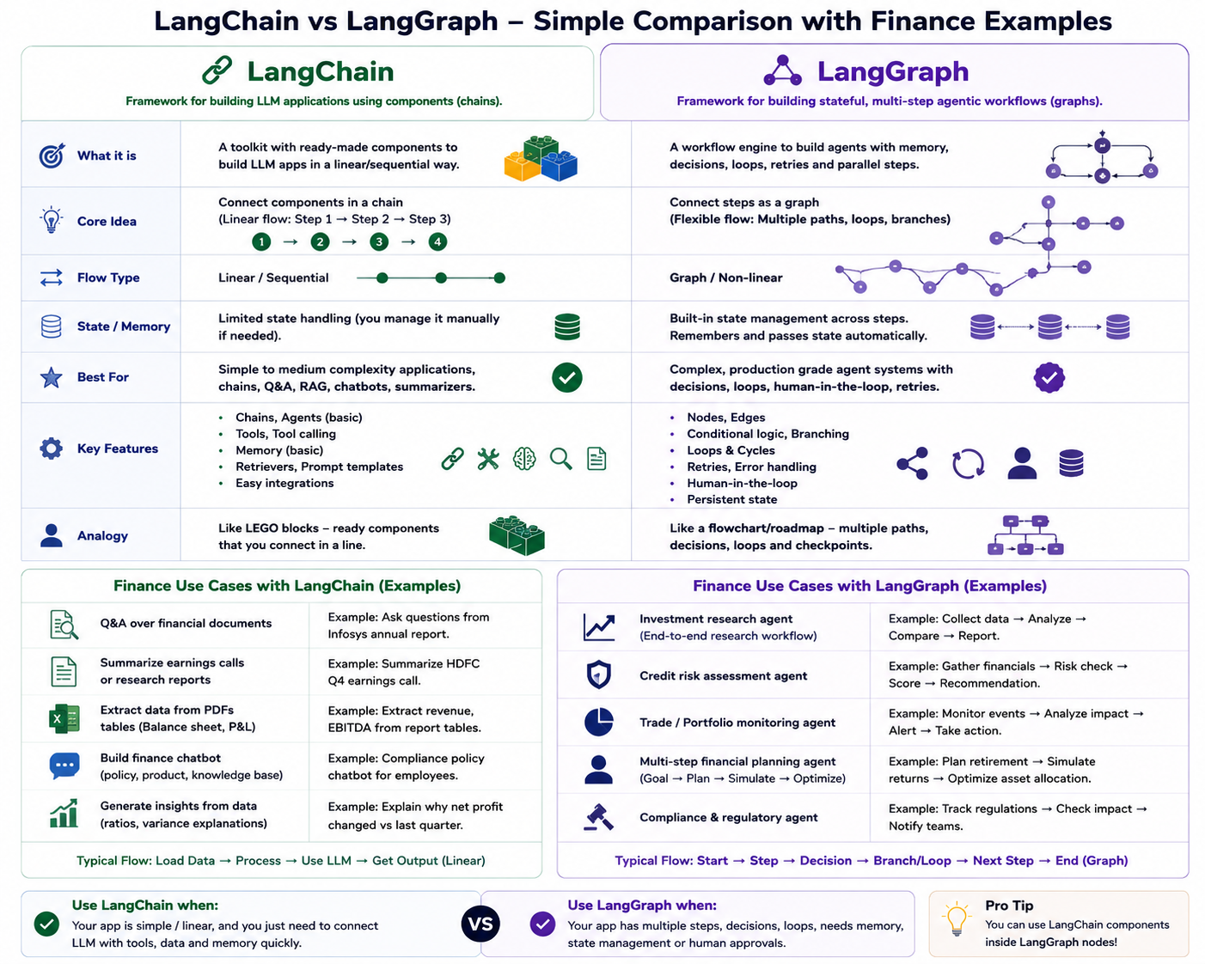

Slide 34
BLOCK E · FRAMEWORKS
LangGraph — when workflows need loops and decisions
From the LangChain team: model your agent as a graph — boxes are steps, arrows are routes, and the system can branch, loop and pause for human approval.
Application in
Extract financials
Credit score ≥ cut-off?
yes
Draft sanction letter
Human approves
pause for sign-off
no
Request documents
then retry
 | LangChain (chains) | LangGraph (graphs)
Path | Fixed, linear | Branches, loops, retries
Human sign-off | Bolted on | Built-in pause points
Use when | Summarise → format → send | Credit approvals, research agents
AI IN FINANCE · SCMHRD ONE-DAY INTENSIVE
SESSION 1 · 30

Slide 35
BLOCK E · FRAMEWORKS
Planning an agentic workflow — design before build
1
Map the human workflow first
Shadow the desk: who does what today, where the hours actually go. Automate what you understand.
2
Define done + the metric
“Drafts the review in 10 min with ≥95% citation accuracy” — not “use AI for portfolios”.
3
Choose the autonomy level
Draft-only → approve-each-step → auto-run with review. Start low; earn autonomy with track record.
4
Give it tools & data — least privilege
Only the MCP connectors and documents this task needs. Nothing more.
5
Add checkpoints & stop rules
Human sign-offs where money or clients are touched; eval gates; loop limits.
6
Pilot → measure → widen
One desk, four weeks, side-by-side against the human baseline. Scale only what wins.
Golden rule: the workflow is the product; the model is a component. Plan the workflow, then pick the AI.
AI IN FINANCE · SCMHRD ONE-DAY INTENSIVE
SESSION 1 · 31

Slide 36
BLOCK E · FRAMEWORKS
Putting it together — enterprise AI architecture
USERS & WORKFLOW — analyst chat · dashboards · approval queues
GOVERNANCE
runs across every layer
▪ Access control
▪ PII & data privacy
▪ Model risk (SR 11-7)
▪ Audit trails
▪ Human sign-off
▪ Evals & monitoring
AGENT / ORCHESTRATION LAYER — LangChain · LangGraph — planning, tools, memory, routing
MODEL LAYER — Claude / GPT / Gemini via API · open models in-house
KNOWLEDGE & TOOLS — RAG: vector DB over filings & policies · market-data APIs · MCP connectors
DATA SOURCES — core banking · risk systems · Bloomberg/Refinitiv · document stores
AI IN FINANCE · SCMHRD ONE-DAY INTENSIVE
SESSION 1 · 32

Slide 37
BLOCK E · FRAMEWORKS
MCP — Model Context Protocol
“USB-C for AI.” One open standard so any AI app can plug into any data source or tool — no custom cable per device.
AI HOST
Claude · ChatGPT · your agent app
▪ Open standard introduced by Anthropic (2024), now industry-wide
▪ An MCP server wraps a system (database, CRM, market data) and exposes safe, described actions
▪ The AI app (host) discovers what's available and calls it — with your permissions
▪ Servers expose three things: tools (actions), resources (data), prompts (templates)
Market-data server
prices · curves · news
Internal-DB server
positions · limits · P&L
CRM server
clients · KYC · emails
the same protocol on every wire — one integration, many systems
Before MCP: every AI app needed a custom integration to every system (N × M problem). After: build one server per system, use it from every AI app.
AI IN FINANCE · SCMHRD ONE-DAY INTENSIVE
SESSION 1 · 33

Slide 38
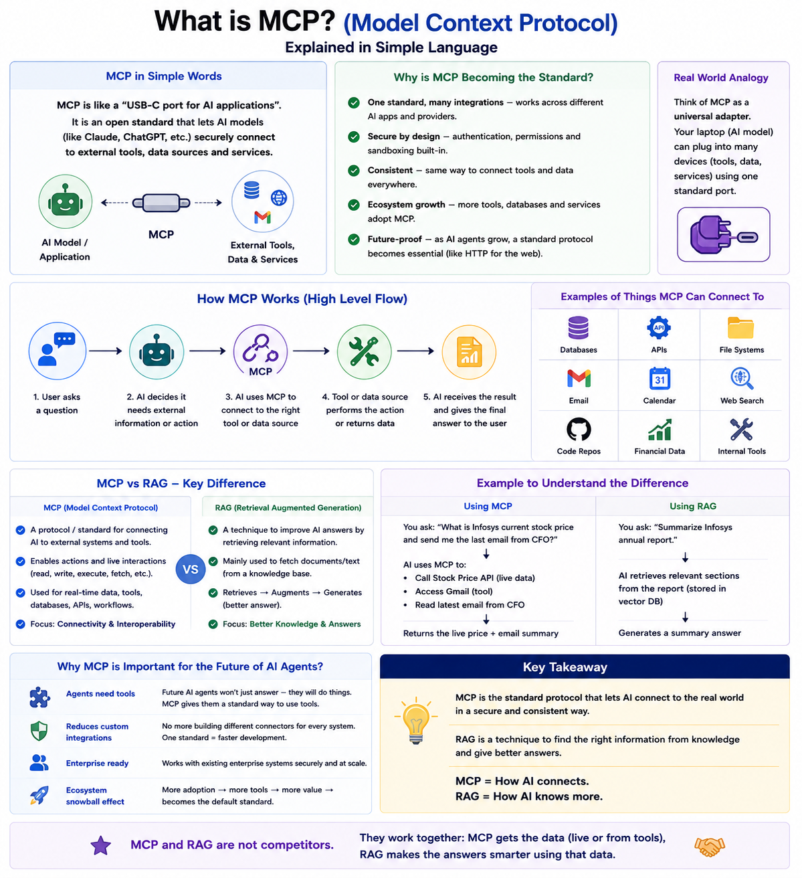

Slide 39
BLOCK E · FRAMEWORKS
MCP in a bank — one analyst agent, every system
9:02 AM — you ask: “Which of my clients are over-exposed to IT stocks after yesterday's fall, and draft the alert emails.”
STEP 1
Market-data MCP
pulls yesterday's sector moves
STEP 2
Portfolio MCP
scans all client holdings for IT weight > limit
STEP 3
CRM MCP
fetches affected clients' contacts & mandates
STEP 4
Email MCP
drafts personalised alerts — for your approval
One conversation. Four systems. Zero copy-paste. The agent orchestrates; every action is logged and the email waits for a human click.
Auditability
every tool call is a logged, permissioned event
Reusability
the same servers power every future AI app the bank builds
Safety
the agent gets narrow, described actions — not raw database access
AI IN FINANCE · SCMHRD ONE-DAY INTENSIVE
SESSION 1 · 34

Slide 40
BLOCK E · FRAMEWORKS
Tools vs RAG vs MCP — three words people mix up
Think of the agent as a new analyst: RAG is the research library she reads · Tools are the actions she can take · MCP is the standard socket both plug into.
 | Tools | RAG | MCP
What it is | Actions the model can call — fetch a price, run Python, send an email | A pattern for answering from your documents, with citations | An open protocol connecting AI apps to systems
Question it answers | “What can the AI DO?” | “What does the AI KNOW?” | “How does it all CONNECT?”
Where it lives | Defined inside your app — each tool is one described action | A pipeline: chunk → embed → vector DB → retrieve → cite | A standard wire between the AI host and servers
Finance example | get_price(“INFY”) · draft_email(client) | Q&A over RBI directions — every answer cites the clause | One market-data server, reused by every AI app in the bank
Fails without it | The AI can only talk — no actions | Answers come from memory — hallucination risk | Every app needs custom wiring to every system (N × M)
How they fit together: MCP servers expose tools; RAG retrieval is itself often a tool; the agent uses all three in one loop — knowledge, hands, socket.
AI IN FINANCE · SCMHRD ONE-DAY INTENSIVE
SESSION 1 · 35

Slide 41
BLOCK E · FRAMEWORKS
Enterprise guardrails — what banks add before go-live
Data privacy & PII
Model risk management
Client data never leaves approved environments; public chatbots are blocked on desks.
Fed SR 11-7 / RBI expectations: validate, document and monitor models — LLMs included.
Access & permissions
Human-in-the-loop
Agents act under the user's entitlements. No agent can see what you can't.
Client-facing and money-moving actions require explicit human approval.
Audit trails
Continuous evals
Every prompt, retrieval and tool call is logged for compliance review.
Automated test suites re-check accuracy and bias every time anything changes. Evals is model centric and Audit is process centric . Evals checks model latency, accuracy. Discussed later
Career note: “AI governance” roles — model validation, AI risk, AI audit — are among the fastest-growing finance jobs. Your MBA + this vocabulary is the entry ticket.
AI IN FINANCE · SCMHRD ONE-DAY INTENSIVE
SESSION 1 · 36

Slide 42
BLOCK E · FRAMEWORKS
Where does your data go? The protection stack
Your document
the confidential filing
Encrypted in transit
TLS — unreadable on the wire
Bank's private AI tenant
Azure OpenAI · Bedrock · on-prem model
Answer back
processed in memory
…and what does NOT happen: your data is not used to train the model, not stored beyond the call, not visible to any other customer (zero-data-retention contracts).
Contract layer
Zero-data-retention and no-training clauses, data-processing agreements, liability terms — negotiated before a single token flows.
Network layer
Private endpoints inside the bank's own cloud tenant. Traffic never touches the public internet or the consumer chatbot.A bank's cloud tenant is a private, isolated slice of cloud infrastructure dedicated exclusively to that specific financial institution.
Data layer
Encryption at rest and in transit; PII masked or redacted before the model ever sees it (“Client A”, not the client's name).
Access & oversight
very call is logged for audit.
This is why your office blocks public ChatGPT but ships an internal copilot: same models — different plumbing and paperwork.
AI IN FINANCE · SCMHRD ONE-DAY INTENSIVE
SESSION 1 · 37

Slide 43
BLOCK E · FRAMEWORKS
Token economics — doing more with fewer tokens
THE BILL = TOKENS IN + TOKENS OUT
Naive approach
100,000
tokens per question — pasting the full annual report every time
With RAG (retrieve 5 chunks)
3,000
tokens per question — ≈ 97% cheaper, and faster to answer
Retrieve, don't paste
RAG sends only the relevant passages, not the whole library.
Cache the static part
Prompt caching: the unchanging instructions are billed once, cheaply. CACHE- SHORT TERM MEMORY
Route by difficulty
Small, cheap model for routine tasks; the big model only for hard ones.
Summarise once, reuse
Distil the 300-page report one time; query the summary all quarter.You only feed the 5-page cheat sheet into your daily queries, instantly cutting your token usage
Cap the output
Ask for 5 bullets, not an essay. Output tokens cost more than input.
Batch the non-urgent
Overnight batch processing runs at roughly half price.
Token optimisation is the new working-capital optimisation — same instinct, different balance sheet.
AI IN FINANCE · SCMHRD ONE-DAY INTENSIVE
SESSION 1 · 38

Slide 44
BLOCK E · FRAMEWORKS
Evals — the exam papers every AI must pass
What's in an eval suite
▪ A golden dataset — 100–1,000 questions with known correct answers
▪ Scoring rules — exact match, rubric, or a second AI as examiner
▪ Pass thresholds — “≥95% accuracy, 100% valid citations”
▪ Run on every change — new model, new prompt, new documents
THE EVAL GATE — HOW AI GOES LIVE
Build / change
new prompt, model, data
yes
Deploy
to the desk
Eval gate
pass?
no
Fix & retry
never reaches users
Monitor
live answers sampled
Desk example — credit-note agent
200 past credit notes become the answer key. Before any release the agent must score ≥95% on ratio accuracy and 100% on citation validity — or it doesn't ship.
Failures found in production are added to the golden set — the exam gets harder every quarter.
MBA angle: designing evals is a judgement job, not a coding job — it's model risk & AI governance work.
House rule: no eval, no deploy — the AI equivalent of “no audit, no accounts.”
AI IN FINANCE · SCMHRD ONE-DAY INTENSIVE
SESSION 1 · 39

Slide 45
INDUSTRY SIGNAL
What the street is building — right now
JPMorgan Chase
$17B
AI spend, 2025. LLM Suite live for 200K+ employees; IndexGPT research; AI on FICC desks.
Morgan Stanley
100K+
wealth documents behind its GPT-4 advisor copilot — the flagship RAG deployment.
Goldman Sachs
95%
of PE firms expected to use AI by 2026; internal coding agents already on the floor.
BloombergGPT
363B
finance tokens trained on — the proof that domain LLMs are worth building.
Kotak · HDFC · Axis
India
wealth bots, KYC automation, regional-language FinBERT, credit underwriting agents.
Citi · Deutsche · UBS
Basel IV
FRTB capital, SA-CVA and Pillar 3 disclosure pipelines going agentic.
AI IN FINANCE · SCMHRD ONE-DAY INTENSIVE
SESSION 1 · 40

Slide 46
INDUSTRY SIGNAL
The project map — who's building what, by name
Company | Project | What it does
JPMorgan | LLM Suite · IndexGPT | Internal ChatGPT for 200K+ staff; AI-built thematic investment indices
Morgan Stanley | AI @ MS · Debrief | RAG copilot over research library; meeting notes auto-drafted into the CRM
Goldman Sachs | GS AI Assistant | Firmwide copilot for drafting, summarising and code on the trading floor
BlackRock | Aladdin Copilot | Natural-language layer over the world's largest risk platform
Citi | Citi Assist · Stylus | Policy navigator for staff; document summarisation at bank scale
Bloomberg | BloombergGPT | 50B-parameter finance-trained LLM inside Terminal workflows
Mastercard | Decision Intelligence Pro | GenAI transaction scoring — fraud detection lifted up to ~300%
HDFC · Kotak · Axis | India AI stack | KYC automation, wealth bots, vernacular FinBERT, credit underwriting agents
Pattern to notice: every project is a copilot, a RAG library or an agent — exactly the three shapes you learned this morning.
AI IN FINANCE · SCMHRD ONE-DAY INTENSIVE
SESSION 1 · 41

Slide 47
CHECKPOINT
Glossary II — systems words, now that you know them
Term | Plain-English meaning | Finance example
System prompt | The standing instructions a builder gives the model | “You are a credit analyst; never estimate missing data”
Fine-tuning | Extra training on your own examples to specialise a model | A model tuned on 10,000 past credit notes
RAG | Fetch the relevant documents, answer only from them, cite | Policy Q&A over RBI master directions
Hallucination | Fluent, confident, wrong — unsupported output | An invented “RBI Circular 2023/114”
Agent | LLM + tools + memory + planning, looping toward a goal | Portfolio-review bot: fetch → compute → draft
Orchestration | The traffic control sequencing models, tools and agents | LangChain chains · LangGraph graphs
MCP | The standard plug connecting AI to systems | One protocol: market data + CRM + risk DB
Guardrail | A hard rule enforced around the model, not by it | “No email leaves without human approval”
Eval | An exam paper you run on the AI before and after changes | 100 known Q&As, scored on every release
AI IN FINANCE · SCMHRD ONE-DAY INTENSIVE
SESSION 1 · 42

Slide 48
CHECKPOINT
Session 1 in nine lines
GenAI
AI that writes, not just scores
LLM
next-word prediction at colossal scale
Context window
the model's desk — what it can see now
Memory
engineered recall across sessions
Hallucination
fluent, confident, wrong — five types
RAG
open-book answers from your documents
Agent
LLM + tools + memory + planning, in a loop
LangChain / LangGraph
pipelines vs decision-graphs
MCP
USB-C: one protocol to plug AI into systems
Lunch · 1 PM — 2 PM. Return with your laptop charged: at 2 PM sharp we start building.
AI IN FINANCE · SCMHRD ONE-DAY INTENSIVE
SESSION 1 · 43

Slide 49
02
Session 2 · Build & Apply
Four live builds, one graded group project — AI writes the code, you supply the finance judgement
2:00
Build 1 · Trading algos
2:45
Build 2 · Backtesting
3:20
Build 3 · Earnings dashboard
3:55
Build 4 · Portfolio + Basel RAG
4:30
Live project briefing
4:50
Careers & close
AI IN FINANCE · SCMHRD ONE-DAY INTENSIVE
SESSION 2 · 44

Slide 50
BUILD 1 OF 4
Trading algo system — momentum & mean reversion
The concept
Momentum: what has been rising tends to keep rising — buy strength. Mean reversion: what has stretched too far from its average tends to snap back — fade extremes. Two opposite philosophies; both reduce to precise, testable rules.
YOU SHIP
A working two-strategy signal engine on Indian equities — built from a plain-English prompt, no coding background.
What we do live (you prompt, AI codes)
▪ Define the rules in plain English (“buy when 20-day return is top decile…”)
▪ Prompt the AI to translate the rules into Python signals
▪ Run on real NIFTY-stock price history in Google Colab
▪ Inspect the trades it would have taken — argue with them
MAPS TO YOUR SYLLABUS
Security Analysis & PM (Sem 2): factor investing, momentum literature, technical vs fundamental debate.
AI IN FINANCE · SCMHRD ONE-DAY INTENSIVE
SESSION 2 · 45

Slide 51
BUILD 2 OF 4
Backtesting — does the strategy actually work?
The concept
A backtest replays your rules over history and scores them. Three numbers matter: Sharpe ratio (return per unit of risk), max drawdown (worst peak-to-trough pain), turnover (how much trading — and cost — the strategy needs).
YOU SHIP
A backtest report card for both strategies — with an honest verdict on whether you'd fund them.
What we do live (you prompt, AI codes)
▪ Feed Build 1's signals into a backtest engine the AI writes
▪ Compute Sharpe, max drawdown, turnover, hit rate
▪ Add transaction costs — watch the edge shrink
▪ Torture test: change the period. Does it survive?
MAPS TO YOUR SYLLABUS
Financial Derivatives & Risk Management: risk-adjusted returns, path dependency, why in-sample success lies (overfitting).
AI IN FINANCE · SCMHRD ONE-DAY INTENSIVE
SESSION 2 · 46

Slide 52
BUILD 3 OF 4
Earnings dashboard — reading the concall for you
The concept
Every quarter, hundreds of pages of earnings calls and press releases land at once. An LLM can read all of it, extract guidance changes, flag tone shifts (FinBERT-style sentiment) and assemble a one-screen dashboard.
YOU SHIP
A live earnings dashboard for one NIFTY company — transcript to insight in 30 minutes.
What we do live (you prompt, AI codes)
▪ Load a real earnings-call transcript (Indian large-cap)
▪ Prompt: extract guidance, margin drivers, capex, one-liners
▪ Score management tone — positive / cautious / evasive
▪ Assemble an HTML dashboard the AI builds for you
MAPS TO YOUR SYLLABUS
Equity Research (Sem 3): earnings quality, guidance analysis, behavioural finance signals in management language.
AI IN FINANCE · SCMHRD ONE-DAY INTENSIVE
SESSION 2 · 47

Slide 53
BUILD 4 OF 4
Portfolio review + Basel report — RAG goes to work
The concept
The morning's RAG concept, applied twice: (a) review a model portfolio against an Investment Policy Statement, and (b) draft a Basel-style capital disclosure section from regulation text. Both answer only from the supplied documents, with citations.
YOU SHIP
An auto-drafted portfolio review memo and a cited Basel disclosure draft — the exact pattern global banks run.
What we do live (you prompt, AI codes)
▪ Load a sample IPS + portfolio holdings file
▪ Agent checks allocation, concentration and mandate breaches
▪ Load Basel III/IV excerpts; prompt a disclosure gap-draft
▪ Every claim must carry a clause citation — we check
MAPS TO YOUR SYLLABUS
Wealth Management + Risk Management (Sem 3): IPS discipline, Basel IV / FRTB context, compliance drafting.
AI IN FINANCE · SCMHRD ONE-DAY INTENSIVE
SESSION 2 · 48

Slide 54
GRADED · GROUP ASSIGNMENT
The live project — your desk for two weeks
THE BRIEF
In teams of 4–5, build one AI-powered finance workflow end-to-end and defend it like an IC pitch: problem → build → demo → what broke → what you'd need to deploy it in a real bank.
GRADING RUBRIC · 100 MARKS
Working demo
30
Finance judgement & accuracy
25
Day 0 — today
Form teams, pick a project from the menu (next slide), get repo access
Hallucination & risk handling
20
Day 4
One-page scope note: user, problem, data source, success metric
Business case & pitch
15
Day 10
Working demo + 5 test questions it must answer correctly
Teamwork & documentation
10
Day 14
15-min pitch: live demo, failure analysis, governance note
Counts toward SCMHRD internal evaluation. Using AI to build is required, not cheating — documenting where it failed earns marks.
AI IN FINANCE · SCMHRD ONE-DAY INTENSIVE
SESSION 2 · 49

Slide 55
PICK ONE
Live project menu — six desks, choose yours
Equity research copilot
RAG over 3 years of one company's filings + calls; answers with citations; drafts a one-page initiation note.
EQUITY RESEARCH
Credit appraisal agent
Reads a borrower's financials, computes ratios, drafts the credit note with covenants and a recommendation.
CORPORATE FINANCE / BANKING
Wealth advisory assistant
IPS-aware chatbot: remembers client profile, checks portfolio drift, drafts the quarterly review letter.
WEALTH MANAGEMENT
Regulatory gap analyser
RAG over an RBI master direction vs a bank's policy doc; produces a cited compliance gap table.
RISK / COMPLIANCE
Deal screener
Agent screens M&A targets on filters, builds comps, drafts a first-cut synergy memo with sources.
M&A & RESTRUCTURING
Treasury FX monitor
Daily agent: pulls FX moves, flags exposures beyond policy bands, drafts the hedging desk note.
TREASURY & FOREX
Templates, datasets and starter prompts for all six: github.com/tejasgjadhav/SCMHRD
AI IN FINANCE · SCMHRD ONE-DAY INTENSIVE
SESSION 2 · 50

Slide 56
LOGISTICS
Your toolkit — nothing to install
ChatGPT / Claude
Your reasoning engine. Free tiers are enough for the project.
chat.openai.com · claude.ai
Google Colab
Python in the browser — the AI writes code, Colab runs it.
colab.research.google.com
Course repository
Slides, prompts, datasets, project templates, submission links.
github.com/tejasgjadhav/SCMHRD
Data sources
NSE bhavcopy, screener.in exports, company filings, RBI/Basel texts — all public.
linked in the repo README
House rule: public data only. No client information, no MNPI, nothing from your internships goes into any AI tool.
AI IN FINANCE · SCMHRD ONE-DAY INTENSIVE
SESSION 2 · 51

Slide 57
SESSION 2 · THE BUILDER'S TOOLBOX
Six tools you'll hear on every AI desk — what each is for
WHAT IT IS
USE IT FOR — AND WHY
Agent harness
The scaffolding around a model — the loop, tools, memory and permissions. Claude Code is a harness.
Turns a chat model into a working agent. The model is the engine; the harness is the car.
OpenClaw
Open-source personal AI assistant that runs on your own machine and talks to you via WhatsApp / Telegram.
A 24×7 personal agent — inbox triage, reminders, files. Shows agents living outside the browser, fully self-hosted.
Hermes (open agent models)
Open-weights models tuned for tool-calling and agent work — you download and run them yourself.
Building agents on your own servers when data can't leave the firm. No API, full control.
GitHub Copilot
AI pair-programmer inside your editor — autocompletes code, answers questions, fixes errors.
Writing the Python for today's builds. Enterprise-approved at most banks — the easiest place to start.
Cursor
An AI-first code editor (a VS Code fork) where the AI can see and edit your whole project.
Bigger changes across many files by describing them in English — the fastest way for non-coders to ship.
VS Code + GitHub
The standard editor wired to GitHub — commits, pull requests and reviews from one screen.
Submitting your group project as a proper repo. The workflow every employer expects you to know.
One line to remember: models think, harnesses act, editors build, GitHub ships. You'll touch all four layers this afternoon.
AI IN FINANCE · SCMHRD ONE-DAY INTENSIVE
SESSION 2

Slide 58
WHERE THIS GOES
AI × Finance careers for an MBA
AI Product Manager — banking
Owns an AI product (advisor copilot, credit agent). Translates desk needs into model requirements.
From today: Today's vocabulary is the job spec
Model risk & AI governance
Validates and audits AI systems for regulators. Scarce, senior-tracked, rising demand.
From today: Hallucination types + SR 11-7 slide
AI-augmented analyst
Equity/credit analyst who ships 3× output using RAG and agents. The near-term default.
From today: Everything you build this afternoon
Fintech / vendor strategy
Builds or sells AI tooling to institutions — solutions, partnerships, product strategy.
From today: MCP & architecture literacy
AI IN FINANCE · SCMHRD ONE-DAY INTENSIVE
SESSION 2 · 52

Slide 59
WHERE THIS GOES
Skill stack → placement map
BUILD THIS STACK IN THE NEXT 6 MONTHS
WHO HIRES IN INDIA — AND FOR WHAT
Prompt fluency
Use AI daily for coursework — it compounds like any language
Global bank GCCs
JPMC, GS, MS, Citi, DB in Pune / Bengaluru / Mumbai — AI product, risk analytics, model validation
One shipped RAG project
Your live project is exactly this — finish it, host it, demo it
Big-4 & consulting
Deloitte, EY, PwC, KPMG, Accenture — AI-in-finance advisory and implementation squads
Python-with-AI comfort
Not coding from scratch — directing AI in Colab and reading its output
Indian banks & NBFCs
Digital units of HDFC, ICICI, Kotak, Axis, Bajaj — copilots, credit agents, wealth bots
Governance vocabulary
Model risk, evals, hallucination types, SR 11-7 — interview gold
Fintechs & vendors
Zerodha to Bloomberg — product, strategy and customer-facing AI roles
Demo storytelling
A 2-minute pitch of your build: problem, demo, what broke, fix
In the interview, don't say “I know AI.” Say: “I built a RAG compliance checker — here's the demo, here's where it hallucinated, here's how I fixed it.”
AI IN FINANCE · SCMHRD ONE-DAY INTENSIVE
SESSION 2 · 53

Slide 60
PLACEMENTS · 2026 SEASON
On campus at SCMHRD — recruiters and their AI bets
Campus recruiter | AI project | What it does
JPMorgan Chase | LLM Suite · IndexGPT | Internal GPT for 200K+ staff; AI research and thematic indices
Goldman Sachs | GS AI Assistant · Devin | Firmwide copilot; autonomous coding agents on the floor
Barclays | Colleague AI (Copilot) | 100,000-seat AI assistant rollout across the bank
HSBC | AI Markets | GenAI analytics powering FX and rates execution for clients
Standard Chartered | SC GPT | In-house GPT rolled out to staff across its markets
DBS | DBS-GPT · CSO Assistant | Asia's AI-first bank — hundreds of models, firmwide GenAI
HDFC Bank · Kotak | EVA · Kai + credit AI | Customer bots, KYC automation, AI-assisted underwriting
CRISIL · CareEdge | GenAI research | AI-assisted ratings notes, sector research and analytics
NPCI | UPI fraud AI | Real-time fraud scoring across billions of UPI transactions
Bain · Big-4 | Sage · Zora · EYQ | AI consulting squads — among the largest MBA hirers
110+ companies came to campus in the 2026 season. Every finance name on this list has a live AI programme — walk in able to talk about theirs.
AI IN FINANCE · SCMHRD ONE-DAY INTENSIVE
SESSION 2 · 54

Slide 61
KEEP GOING
After today — a 30-day path
Week 1
Re-run all four builds solo. Change one assumption in each; watch what breaks.
READING LIST
▪ Anthropic — “Building effective agents”
▪ DeepLearning.AI — short courses on RAG & LangChain (free)
▪ BloombergGPT paper — skim the use cases
▪ Morgan Stanley × OpenAI case study
▪ RBI & BIS papers on AI in banking
All linked in the course repo.
Week 2
Ship your project scope note. Read one bank AI case study (Morgan Stanley RAG is the classic).
Week 3
Working demo. Add one guardrail: citations, “I don't know”, or a human-approval step.
Week 4
Pitch. Then put the demo on your CV with metrics — “built a RAG compliance tool, 90% citation accuracy”.
AI IN FINANCE · SCMHRD ONE-DAY INTENSIVE
SESSION 2 · 55

Slide 62
SCMHRD · MBA FINANCE · AI IN FINANCE INTENSIVE
Build the thing. Question the output.
AI won't replace finance professionals — finance professionals who use AI will replace those who don't.
Tejas Jadhav, CFA, FRM
Guest Faculty · AI in Finance
github.com/tejasgjadhav/SCMHRD
Slides, prompts, datasets & project templates live here.
YOUR NEXT STEP
Form your team before you leave the room. Scope note due Day 4.
AI IN FINANCE · SCMHRD ONE-DAY INTENSIVE
CLOSE · 56

